Slide 1
Superstore Business Intelligence Dashboard

Slide 2


Business Problem
Retail leadership lacks clear visibility into:
Product profitability
Regional performance
Impact of discounts on profit
Customer segment contribution
This creates challenges in:
Identifying profitable products
Optimizing discount strategies
Expanding high-performing markets
Key Objective
Build a decision-focused analytics dashboard to identify growth opportunities and profit risks.

Slide 3
Dataset Description
Dataset: Superstore Retail Dataset
Data Contains
Data Category Example Fields Orders Order ID, Order Date Products Category, Sub-Category Customers Segment
Location Region, State
Sales Metrics Sales, Profit, Quantity, Discount Dataset Size
Example:
~10,000 orders 3product categories 17 sub-categories
4 regions
Purpose:
Understand sales performance, profitability, and market behavior.

Slide 4

Data Cleaning & Preparation
Key steps performed:
Removed invalid rows and data errors
Standardized date formats
Converted numeric columns to numeric type
Created date hierarchy(Year, Month, Quarter)
Built a Star Schema data model
Data Model Fact Table:
Superstore Sales Dimension Tables:
Date Product Customer Location
This structure improves query performance and analytical clarity.

Slide 5
Dashboard Architecture
Dashboard Design
The solution consists of three analytical dashboards. Page Purpose
Executive Dashboard Overall business performance Product Analysis Product profitability insights Regional Analysis Market performance
This layered design enables executive overview → deep analysis.

Slide 6
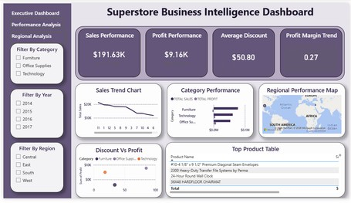
Executive Dashboard
Key metrics displayed:
Total Sales
Total Profit
Profit Margin
Total Orders
Average Discount
Additional insights:
Sales trend over time
Profit trend over time
Category performance
Regional performance
Enable leadership to understand overall business health in seconds.
Executive Dashboard Walkthrough

Slide 7
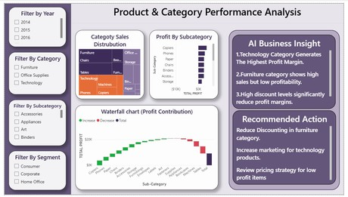
Product & Category Insights
Analysis includes:
Category sales distribution
Sub-category profitability
Top performing products
Quantity vs Profit relationship
Profit contribution waterfall chart
Which products drive revenue and which destroy profit?
Product Performance Analysis

Slide 8
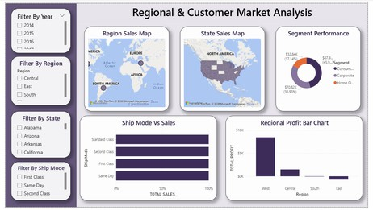
Market Performance Insights
This page analyzes:
Regional sales distribution
State-level performance
Customer segment contribution
Shipping method impact on sales
Regional profitability comparison
Purpose:
Identify high-performing markets and expansion opportunities.
Regional & Customer Analysis

Slide 9
Key Business Insights
Key Insights
1.
2.
3.
4.
5.
Technology category generates the highest profit margin Furniture category shows high sales but low profitability West region contributes the largest revenue share Consumer segment drives majority of sales
Higher discounts strongly correlate with lower profit

Slide 10

Business Interpretation
What the Data Tells Us
Analysis reveals several important patterns:
Discount strategies significantly affect profitability
Certain sub-categories drive most profit contribution
High sales does not always translate to high profit
Regional performance varies significantly
This indicates the need for strategic pricing and market optimization.
Business Interpretation

Slide 11
Strategic Recommendations
Recommended Actions
1.
2.
3.
4.
5.
Reduce discounting in the Furniture category
Increase marketing investment in Technology products Expand operations in high-performing regions (West) Optimize logistics for low-profit regions
Focus marketing campaigns on high-value customer
segments
These actions can significantly improve profit margins and market growth.

Slide 12
Final Summary
Conclusion
This project demonstrates how business intelligence dashboards can transform raw data into actionable insights.
Key outcomes:
Clear visibility into product performance
Identification of profit-destroying discounts
Insights into regional market performance
Strategic recommendations for growth
Final Insight
Furniture category drives high sales but suffers from negative profit due to heavy discounting.
Reducing discounts by 10% could significantly improve profit margins.

Slide 13
THANKYOU

